Slide 1
Text Classification and Naive Bayes
The Task of Text Classification

Slide 2
Is this spam?

Slide 3
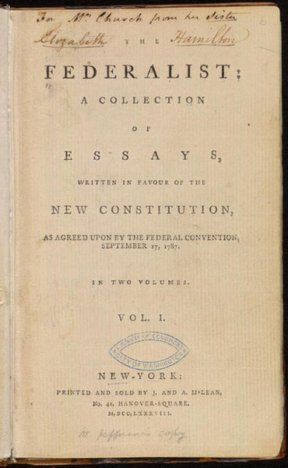
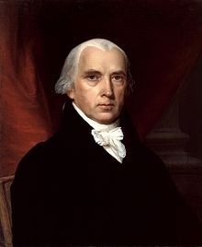
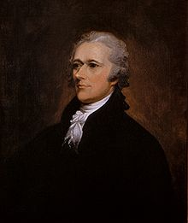
Who wrote which Federalist papers?
1787-8: anonymous essays try to convince New York to ratify U.S Constitution: Jay, Madison, Hamilton.
Authorship of 12 of the letters in dispute
1963: solved by Mosteller and Wallace using Bayesian methods
James Madison
Alexander Hamilton

Slide 4
What is the subject of this medical article?
MEDLINE Article
MeSH Subject Category Hierarchy
Antogonists and Inhibitors
Blood Supply
Chemistry
Drug Therapy
Embryology
Epidemiology
…
?

Slide 5
Positive or negative movie review?
+
...zany characters and richly applied satire, and some great plot twists
It was pathetic. The worst part about it was the boxing scenes...
...awesome caramel sauce and sweet toasty almonds. I love this place!
...awful pizza and ridiculously overpriced...
−
+
−

Slide 6
Positive or negative movie review?
+
...zany characters and richly applied satire, and some great plot twists
It was pathetic. The worst part about it was the boxing scenes...
...awesome caramel sauce and sweet toasty almonds. I love this place!
...awful pizza and ridiculously overpriced...
−
+
−

Slide 7
Why sentiment analysis?
Movie: is this review positive or negative?
Products: what do people think about the new iPhone?
Public sentiment: how is consumer confidence?
Politics: what do people think about this candidate or issue?
Prediction: predict election outcomes or market trends from sentiment

Slide 8
Scherer Typology of Affective States
Emotion: brief organically synchronized … evaluation of a major event
  angry, sad, joyful, fearful, ashamed, proud, elated
Mood: diffuse non-caused low-intensity long-duration change in subjective feeling
  cheerful, gloomy, irritable, listless, depressed, buoyant
Interpersonal stances: affective stance toward another person in a specific interaction
  friendly, flirtatious, distant, cold, warm, supportive, contemptuous
Attitudes: enduring, affectively colored beliefs, dispositions towards objects or persons
  liking, loving, hating, valuing, desiring
Personality traits: stable personality dispositions and typical behavior tendencies
  nervous, anxious, reckless, morose, hostile, jealous

Slide 9
Scherer Typology of Affective States
Emotion: brief organically synchronized … evaluation of a major event
  angry, sad, joyful, fearful, ashamed, proud, elated
Mood: diffuse non-caused low-intensity long-duration change in subjective feeling
  cheerful, gloomy, irritable, listless, depressed, buoyant
Interpersonal stances: affective stance toward another person in a specific interaction
  friendly, flirtatious, distant, cold, warm, supportive, contemptuous
Attitudes: enduring, affectively colored beliefs, dispositions towards objects or persons
  liking, loving, hating, valuing, desiring
Personality traits: stable personality dispositions and typical behavior tendencies
  nervous, anxious, reckless, morose, hostile, jealous

Slide 10
Basic Sentiment Classification
Sentiment analysis is the detection of attitudes
Simple task we focus on in this chapter
  Is the attitude of this text positive or negative?
We return to affect classification in later chapters

Slide 11
Summary: Text Classification
Sentiment analysis
Spam detection
Authorship identification
Language Identification
Assigning subject categories, topics, or genres
…

Slide 12
Text Classification: definition
Input:
  a document d
  a fixed set of classes C = {c₁, c₂,…, c_{J}}
Output: a predicted class c ∈ C

Slide 13
Classification Methods: Hand-coded rules
Rules based on combinations of words or other features
  spam: black-list-address OR (“dollars” AND “you have been selected”)
Accuracy can be high
  If rules carefully refined by expert
But building and maintaining these rules is expensive

Slide 14
Classification Methods:
Supervised Machine Learning
Input:
  a document d
  a fixed set of classes C = {c₁, c₂,…, c_{J}}
  A training set of m hand-labeled documents (d₁,c₁),....,(d_{m},c_{m})
Output:
  a learned classifier γ:d → c

Slide 15
Classification Methods:
Supervised Machine Learning
Any kind of classifier
  Naïve Bayes
  Logistic regression
  Neural networks
  k-Nearest Neighbors
  …

Slide 16
Text Classification and Naive Bayes
The Task of Text Classification

Slide 17
Text Classification and Naive Bayes
The Naive Bayes Classifier
Notes:
In this lecture we define the Naive Bayes classifier, a basic text classifier that will allow us to introduce many of the fundamental issues in text classification.

Slide 18
Naive Bayes Intuition
Simple ("naive") classification method based on Bayes rule
Relies on very simple representation of document
  Bag of words

Slide 19
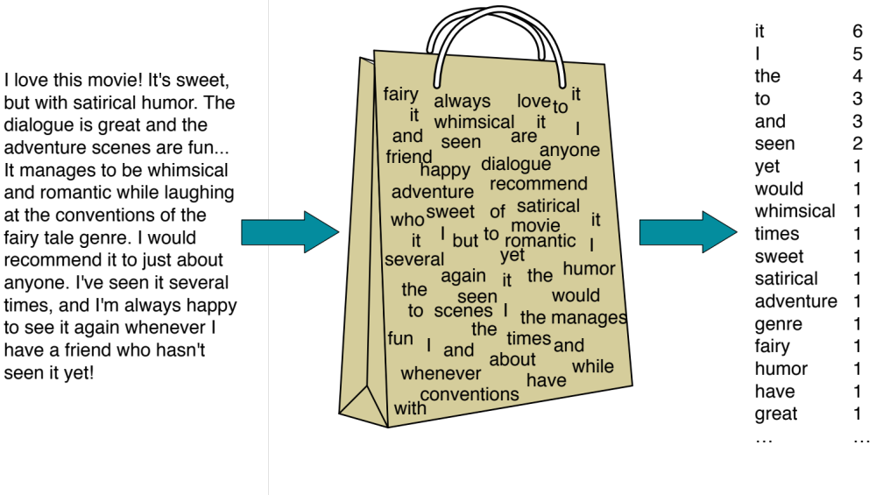
The Bag of Words Representation

Slide 20


The bag of words representation
seen | 2
sweet | 1
whimsical | 1
recommend | 1
happy | 1
... | ...
γ(
)=c

Slide 21
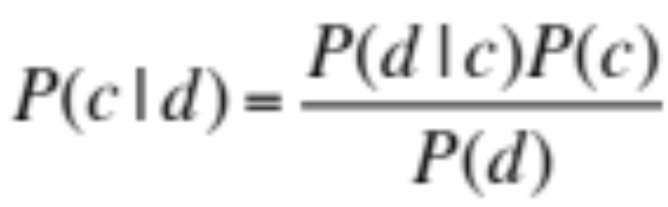
Bayes’ Rule Applied to Documents and Classes
For a document d and a class c

Slide 22
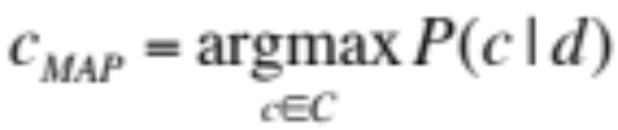
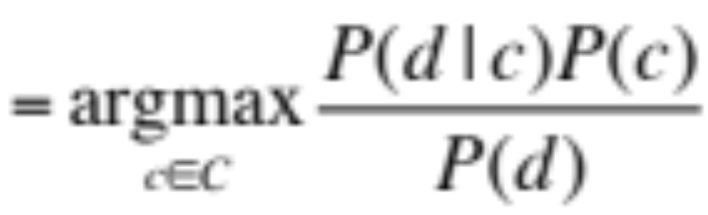
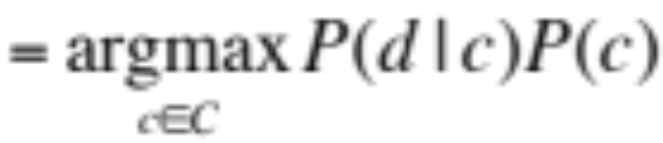
Naive Bayes Classifier (I)
MAP is “maximum a posteriori” = most likely class
Bayes Rule
Dropping the denominator

Slide 23
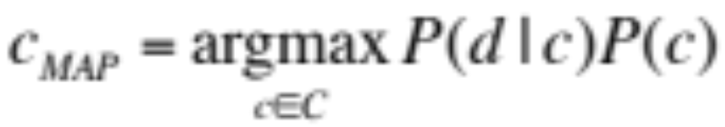
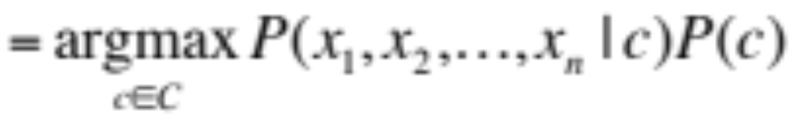
Naive Bayes Classifier (II)
"Likelihood"
"Prior"
Document d represented as features x1..xn

Slide 24
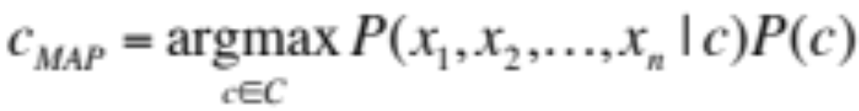
Naïve Bayes Classifier (IV)
  O(|X|^{n}•|C|) parameters
How often does this class occur?
  Could only be estimated if a very, very large number of training examples was available.
We can just count the relative frequencies in a corpus

Slide 25
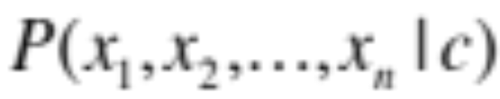
Multinomial Naive Bayes Independence Assumptions
Bag of Words assumption: Assume position doesn’t matter
Conditional Independence: Assume the feature probabilities P(x_{i}|c_{j}) are independent given the class c.

Slide 26
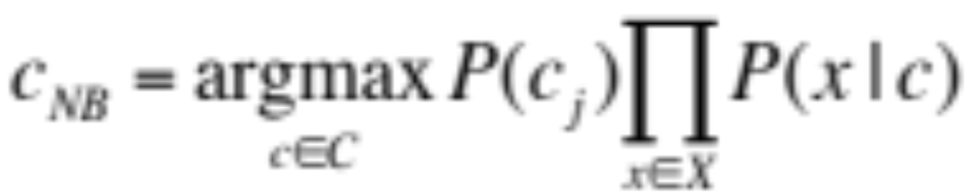
Multinomial Naive Bayes Classifier

Slide 27
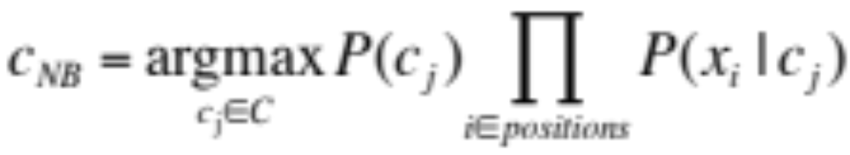
Applying Multinomial Naive Bayes Classifiers to Text Classification
positions ← all word positions in test document

Slide 28
Problems with multiplying lots of probs
There's a problem with this:
Multiplying lots of probabilities can result in floating-point underflow!
.0006 * .0007 * .0009 * .01 * .5 * .000008….
Idea: Use logs, because log(ab) = log(a) + log(b)
We'll sum logs of probabilities instead of multiplying probabilities!

Slide 29
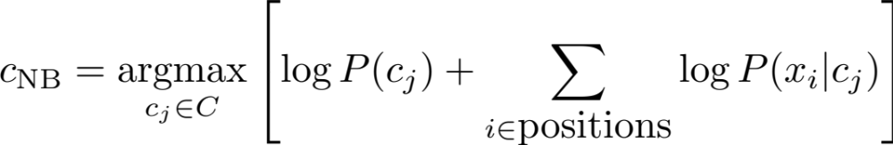
We actually do everything in log space
Instead of this:
This:
Notes:
  1) Taking log doesn't change the ranking of classes!
  The class with highest probability also has highest log probability!
  2) It's a linear model:
  Just a max of a sum of weights: a linear function of the inputs
  So naive bayes is a linear classifier

Slide 30
Text Classification and Naive Bayes
The Naive Bayes Classifier
Notes:
We've now seen the basic principles of naïve bayes classification!

Slide 31
Text Classification and Naïve Bayes
Naive Bayes: Learning

Slide 32
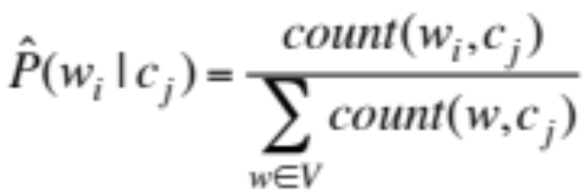
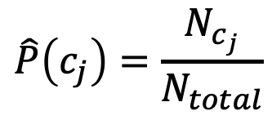
Learning the Multinomial Naive Bayes Model
Sec.13.3
First attempt: maximum likelihood estimates
  simply use the frequencies in the data
$$\hat{P}\left(c_{j}\right)=\frac{N_{c_{j}}}{N_{total}}$$

Slide 33
Parameter estimation
fraction of times word w_{i} appears
among all words in documents of topic c_{j}
Create mega-document for topic j by concatenating all docs in this topic
  Use frequency of w in mega-document

Slide 34
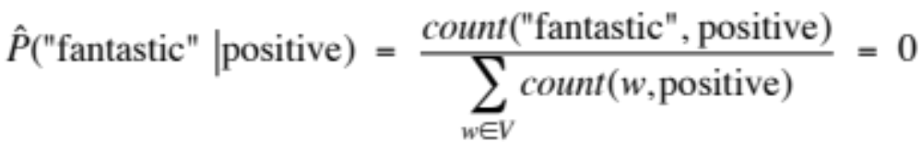
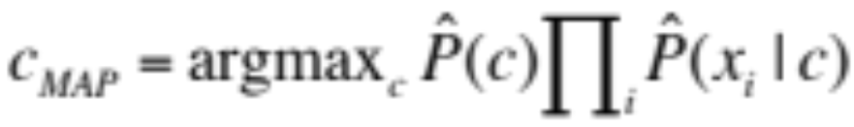
Problem with Maximum Likelihood
Sec.13.3
What if we have seen no training documents with the word fantastic and classified in the topic positive (thumbs-up)?
Zero probabilities cannot be conditioned away, no matter the other evidence!

Slide 35
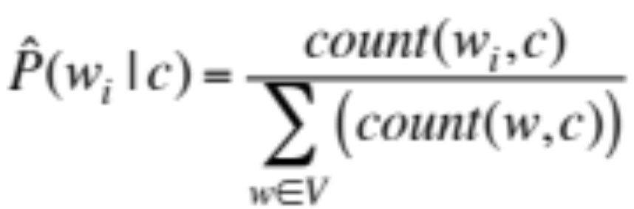
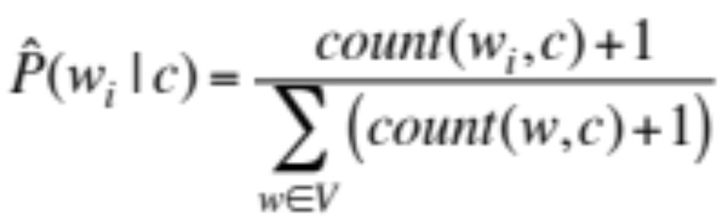
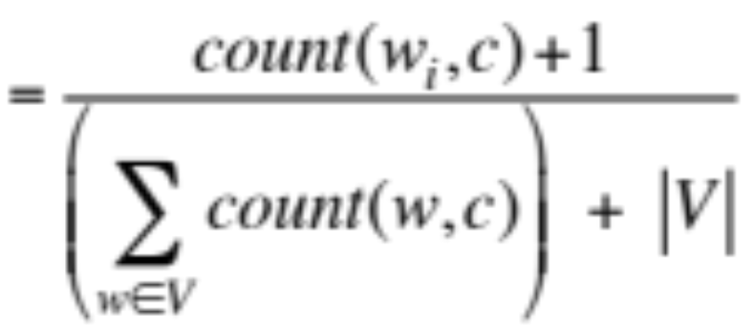
Laplace (add-1) smoothing for Naïve Bayes

Slide 36
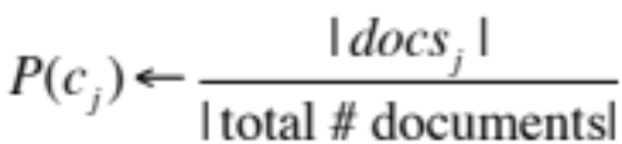
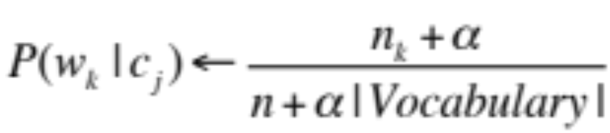
Multinomial Naïve Bayes: Learning
From training corpus, extract Vocabulary
Calculate P(c_{j}) terms
  For each c_{j} in C do
    docs_{j} ← all docs with class =c_{j}
Calculate P(w_{k} | c_{j}) terms
  Text_{j} ← single doc containing all docs_{j}
  For each word w_{k} in Vocabulary
    n_{k} ← # of occurrences of w_{k} in Text_{j}

Slide 37
Unknown words
What about unknown words
  that appear in our test data
  but not in our training data or vocabulary?
We ignore them
  Remove them from the test document!
  Pretend they weren't there!
  Don't include any probability for them at all!
Why don't we build an unknown word model?
  It doesn't help: knowing which class has more unknown words is not generally helpful!

Slide 38
Stop words
Some systems ignore stop words
  Stop words: very frequent words like the and a.
    Sort the vocabulary by word frequency in training set
    Call the top 10 or 50 words the stopword list.
    Remove all stop words from both training and test sets
      As if they were never there!
But removing stop words doesn't usually help
  So in practice most NB algorithms use all words and don't use stopword lists

Slide 39
Text Classification and Naive Bayes
Naive Bayes: Learning

Slide 40
Text Classification and Naive Bayes
Sentiment and Binary Naive Bayes
Notes:
In this lecture we'll do a worked example of naïve bayes sentiment analysis, and also introduce the binary multinominal naïve bayes algorithm.

Slide 41
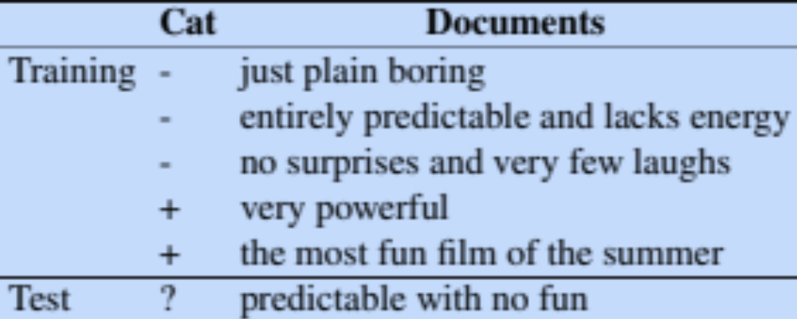
Let's do a worked sentiment example!

Slide 42
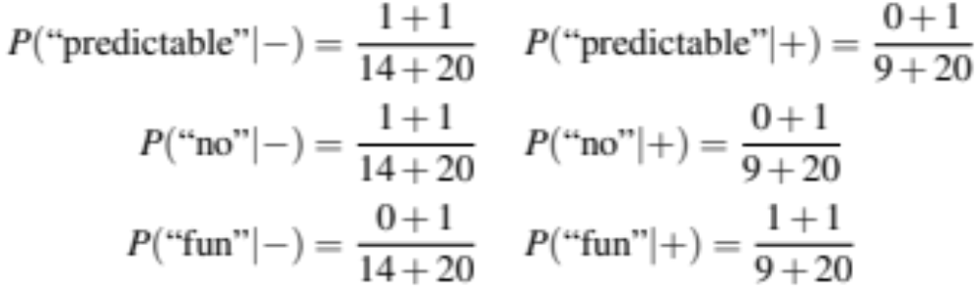
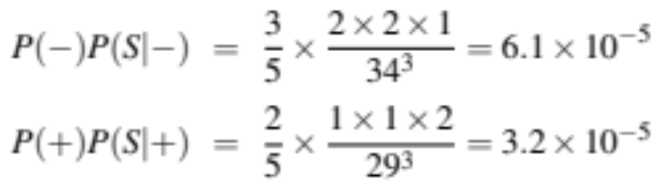
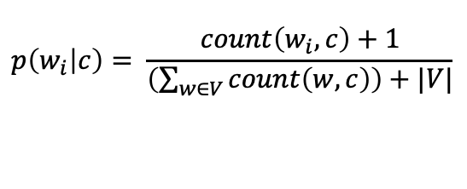
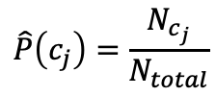
A worked sentiment example with add-1 smoothing
1. Prior from training:
$$\hat{P}\left(c_{j}\right)=\frac{N_{c_{j}}}{N_{total}}$$
P(-) = 3/5
P(+) = 2/5
2. Drop "with"
3. Likelihoods from training:
$$p\left(w_{i} | c\right)= \frac{count\left(w_{i},c\right)+1}{\left(\sum_{w∈V}{count\left(w,c\right)}\right)+|V|}$$
4. Scoring the test set:

Slide 43
Optimizing for sentiment analysis
For tasks like sentiment, word occurrence seems to be more important than word frequency.
    The occurrence of the word fantastic tells us a lot
    The fact that it occurs 5 times may not tell us much more.
Binary multinominal naive bayes, or binary NB
  Clip our word counts at 1
  Note: this is different than Bernoulli naive bayes; see the textbook at the end of the chapter.

Slide 44
Binary Multinomial Naïve Bayes: Learning
From training corpus, extract Vocabulary
Calculate P(c_{j}) terms
  For each c_{j} in C do
    docs_{j} ← all docs with class =c_{j}
Calculate P(w_{k} | c_{j}) terms
  Text_{j} ← single doc containing all docs_{j}
  For each word w_{k} in Vocabulary
    n_{k} ← # of occurrences of w_{k} in Text_{j}
  Remove duplicates in each doc:
    For each word type w in doc_{j}
      Retain only a single instance of w

Slide 45
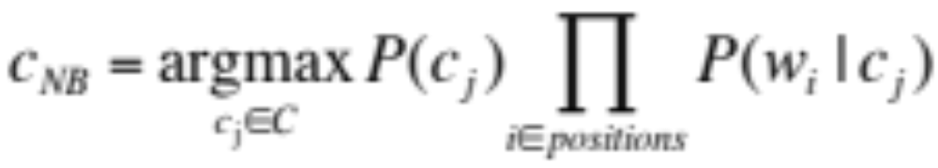
Binary Multinomial Naive Bayes on a test document d
First remove all duplicate words from d
Then compute NB using the same equation:

Slide 46
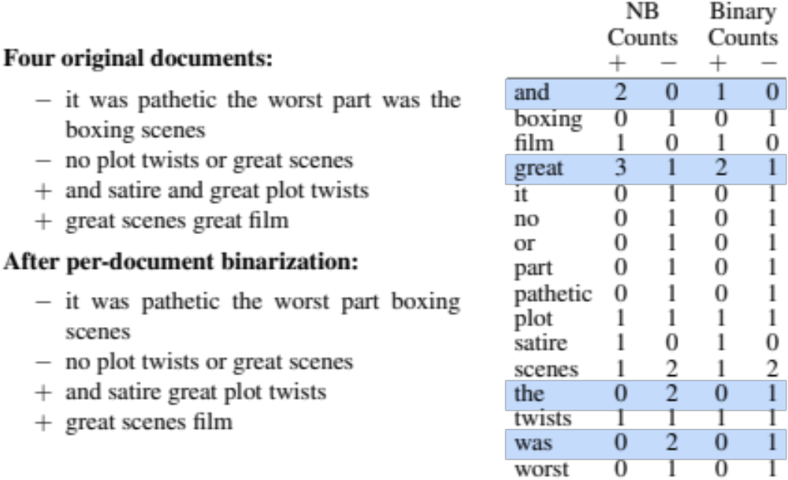
Binary multinominal naive Bayes

Slide 47
Binary multinominal naive Bayes

Slide 48
Binary multinominal naive Bayes

Slide 49
Binary multinominal naive Bayes
Counts can still be 2! Binarization is within-doc!

Slide 50
Text Classification and Naive Bayes
Sentiment and Binary Naive Bayes

Slide 51
Text Classification and Naive Bayes
More on Sentiment Classification

Slide 52
Sentiment Classification: Dealing with Negation
I really like this movie
I really don't like this movie
Negation changes the meaning of "like" to negative.
Negation can also change negative to positive-ish
  Don't dismiss this film
  Doesn't let us get bored

Slide 53
Sentiment Classification: Dealing with Negation
Das, Sanjiv and Mike Chen. 2001. Yahoo! for Amazon: Extracting market sentiment from stock message boards. In Proceedings of the Asia Pacific Finance Association Annual Conference (APFA).
Bo Pang, Lillian Lee, and Shivakumar Vaithyanathan. 2002. Thumbs up? Sentiment Classification using Machine Learning Techniques. EMNLP-2002, 79—86.
Simple baseline method:
Add NOT_ to every word between negation and following punctuation:
didn’t like this movie , but I
didn’t NOT_like NOT_this NOT_movie but I

Slide 54
Sentiment Classification: Lexicons
Sometimes we don't have enough labeled training data
In that case, we can make use of pre-built word lists
Called lexicons
There are various publically available lexicons

Slide 55
MPQA Subjectivity Cues Lexicon
Theresa Wilson, Janyce Wiebe, and Paul Hoffmann (2005). Recognizing Contextual Polarity in
Phrase-Level Sentiment Analysis. Proc. of HLT-EMNLP-2005.
Riloff and Wiebe (2003). Learning extraction patterns for subjective expressions. EMNLP-2003.
Home page: https://mpqa.cs.pitt.edu/lexicons/subj_lexicon/
6885 words from 8221 lemmas, annotated for intensity (strong/weak)
  2718 positive
  4912 negative
+ : admirable, beautiful, confident, dazzling, ecstatic, favor, glee, great
− : awful, bad, bias, catastrophe, cheat, deny, envious, foul, harsh, hate

Slide 56
The General Inquirer
Philip J. Stone, Dexter C Dunphy, Marshall S. Smith, Daniel M. Ogilvie. 1966. The General Inquirer: A Computer Approach to Content Analysis. MIT Press
  Home page: http://www.wjh.harvard.edu/~inquirer
  List of Categories: http://www.wjh.harvard.edu/~inquirer/homecat.htm
  Spreadsheet: http://www.wjh.harvard.edu/~inquirer/inquirerbasic.xls
Categories:
  Positiv (1915 words) and Negativ (2291 words)
  Strong vs Weak, Active vs Passive, Overstated versus Understated
  Pleasure, Pain, Virtue, Vice, Motivation, Cognitive Orientation, etc
Free for Research Use

Slide 57
Using Lexicons in Sentiment Classification
Add a feature that gets a count whenever a word from the lexicon occurs
  E.g., a feature called "this word occurs in the positive lexicon" or "this word occurs in the negative lexicon"
Now all positive words (good, great, beautiful, wonderful) or negative words count for that feature.
Using 1-2 features isn't as good as using all the words.
  But when training data is sparse or not representative of the test set, dense lexicon features can help

Slide 58
Naive Bayes in Other tasks: Spam Filtering
SpamAssassin Features:
  Mentions millions of (dollar) ((dollar) NN,NNN,NNN.NN)
  From: starts with many numbers
  Subject is all capitals
  HTML has a low ratio of text to image area
  "One hundred percent guaranteed"
  Claims you can be removed from the list

Slide 59
Naive Bayes in Language ID
Determining what language a piece of text is written in.
Features based on character n-grams do very well
Important to train on lots of varieties of each language
  (e.g., American English varieties like African-American English, or English varieties around the world like Indian English)

Slide 60
Summary: Naive Bayes is Not So Naive
Very Fast, low storage requirements
Work well with very small amounts of training data
Robust to Irrelevant Features
  Irrelevant Features cancel each other without affecting results
Very good in domains with many equally important features
  Decision Trees suffer from fragmentation in such cases – especially if little data
Optimal if the independence assumptions hold: If assumed independence is correct, then it is the Bayes Optimal Classifier for problem
A good dependable baseline for text classification
  But we will see other classifiers that give better accuracy
Slide from Chris Manning

Slide 61
Text Classification and Naive Bayes
More on Sentiment Classification

Slide 62
Text Classification and Naïve Bayes
Naïve Bayes: Relationship to Language Modeling

Slide 63
Generative Model for Multinomial Naïve Bayes
c=+
X₁=I
X₂=love
X₃=this
X₄=fun
X₅=film

Slide 64
Naïve Bayes and Language Modeling
Naïve bayes classifiers can use any sort of feature
  URL, email address, dictionaries, network features
But if, as in the previous slides
  We use only word features
  we use all of the words in the text (not a subset)
Then
  Naive bayes has an important similarity to language modeling.

Slide 65
Each class = a unigram language model
Sec.13.2.1
Assigning each word: P(word | c)
Assigning each sentence: P(s|c)=Π P(word|c)
Class pos
0.1 I
0.1 love
0.01 this
0.05 fun
0.1 film
…
I
love
this
fun
film
0.1
0.1
.05
0.01
0.1
P(s | pos) = 0.0000005

Slide 66
Naïve Bayes as a Language Model
Sec.13.2.1
Which class assigns the higher probability to s?
Model pos
Model neg
0.2 I
0.001 love
0.01 this
0.005 fun
0.1 film
0.1 I
0.1 love
0.01 this
0.05 fun
0.1 film
I
love
this
fun
film
0.1
0.1
0.01
0.05
0.1
0.2
0.001
0.01
0.005
0.1
P(s|pos) > P(s|neg)

Slide 67
Text Classification and Naïve Bayes
Naïve Bayes: Relationship to Language Modeling

Slide 68
Text Classification and Naïve Bayes
Precision, Recall, and F measure

Slide 69
Evaluation
Let's consider just binary text classification tasks
Imagine you're the CEO of Delicious Pie Company
You want to know what people are saying about your pies
So you build a "Delicious Pie" tweet detector
  Positive class: tweets about Delicious Pie Co
  Negative class: all other tweets

Slide 70
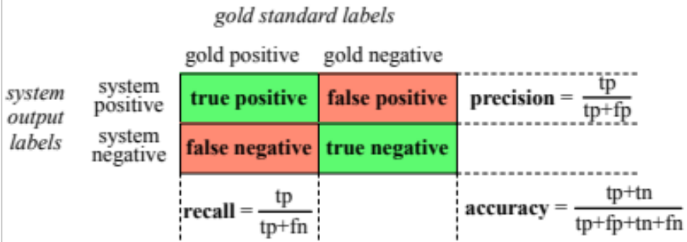
The 2-by-2 confusion matrix

Slide 71
Evaluation: Accuracy
Why don't we use accuracy as our metric?
Imagine we saw 1 million tweets
  100 of them talked about Delicious Pie Co.
  999,900 talked about something else
We could build a dumb classifier that just labels every tweet "not about pie"
  It would get 99.99% accuracy!!! Wow!!!!
  But useless! Doesn't return the comments we are looking for!
  That's why we use precision and recall instead

Slide 72
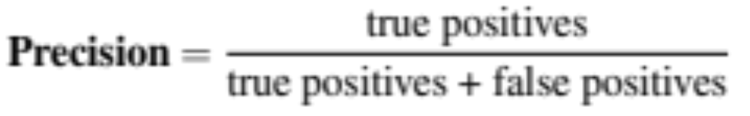
Evaluation: Precision
% of items the system detected (i.e., items the system labeled as positive) that are in fact positive (according to the human gold labels)

Slide 73
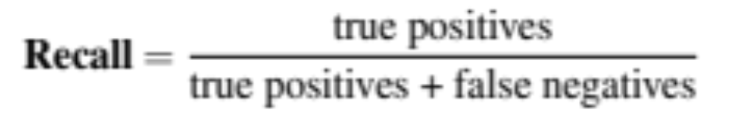
Evaluation: Recall
% of items actually present in the input that were correctly identified by the system.

Slide 74
Why Precision and recall
Our dumb pie-classifier
  Just label nothing as "about pie"
Accuracy=99.99%
  but
Recall = 0
  (it doesn't get any of the 100 Pie tweets)
Precision and recall, unlike accuracy, emphasize true positives:
  finding the things that we are supposed to be looking for.

Slide 75
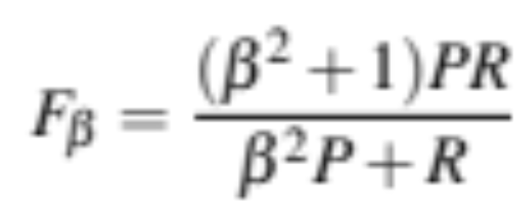
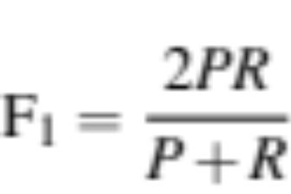
A combined measure: F
F measure: a single number that combines P and R:
We almost always use balanced F₁ (i.e., β = 1)

Slide 76
Development Test Sets ("Devsets") and Cross-validation
Train on training set, tune on devset, report on testset
  This avoids overfitting (‘tuning to the test set’)
  More conservative estimate of performance
  But paradox: want as much data as possible for training, and as much for dev; how to split?
Training set
Development Test Set
Test Set

Slide 77
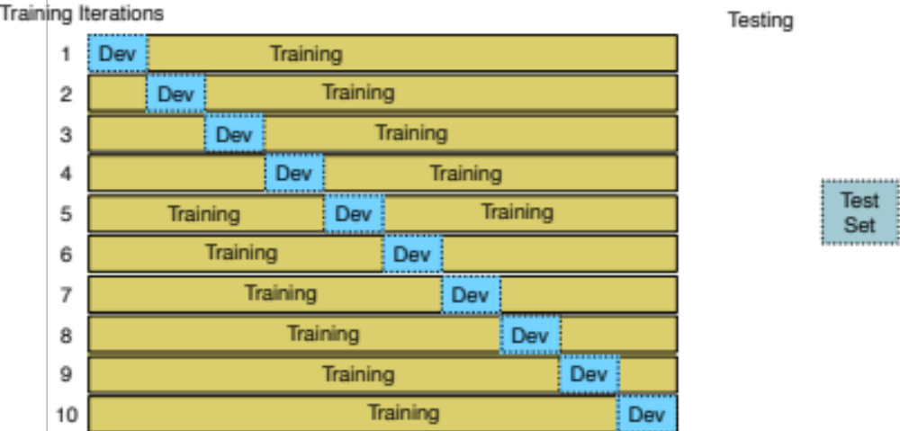
Cross-validation: multiple splits
Pool results over splits, Compute pooled dev performance

Slide 78
Text Classification and Naive Bayes
Precision, Recall, and F measure

Slide 79
Text Classification and Naive Bayes
Evaluation with more than two classes

Slide 80
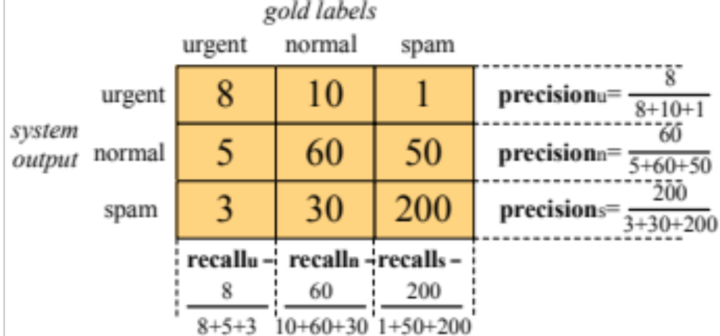
Confusion Matrix for 3-class classification

Slide 81
How to combine P/R from 3 classes to get one metric
Macroaveraging:
  compute the performance for each class, and then average over classes
Microaveraging:
  collect decisions for all classes into one confusion matrix
  compute precision and recall from that table.

Slide 82
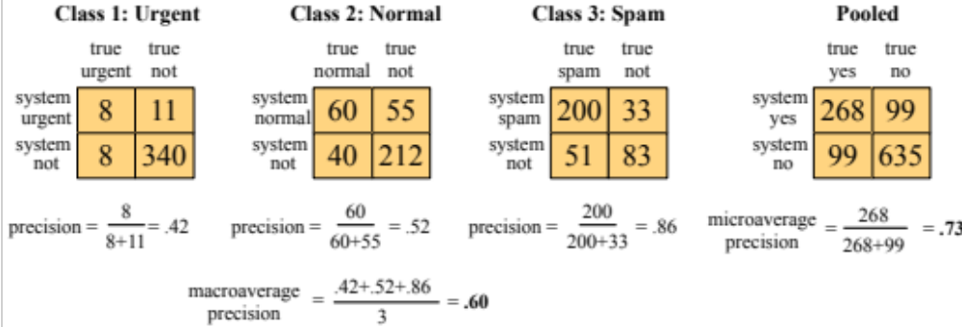
Macroaveraging and Microaveraging

Slide 83
Text Classification and Naive Bayes
Evaluation with more than two classes

Slide 84
Text Classification and Naive Bayes
Statistical Significance Testing

Slide 85
How do we know if one classifier is better than another?
Given:
  Classifier A and B
  Metric M: M(A,x) is the performance of A on testset x
  𝛿(x): the performance difference between A, B on x:
    𝛿(x) = M(A,x) – M(B,x)
  We want to know if 𝛿(x)>0, meaning A is better than B
  𝛿(x) is called the effect size
  Suppose we look and see that 𝛿(x) is positive. Are we done?
  No! This might be just an accident of this one test set, or circumstance of the experiment. Instead:

Slide 86
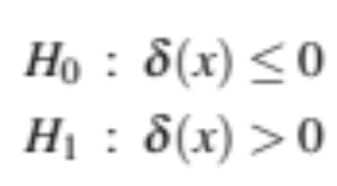
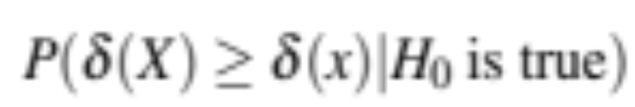
Statistical Hypothesis Testing
Consider two hypotheses:
  Null hypothesis: A isn't better than B
  A is better than B
We want to rule out H₀
We create a random variable X ranging over test sets
And ask, how likely, if H₀ is true, is it that among these test sets we would see the 𝛿(x) we did see?
Formalized as the p-value:

Slide 87
Statistical Hypothesis Testing
  In our example, this p-value is the probability that we would see δ(x) assuming H₀ (=A is not better than B).
    If H₀ is true but δ(x) is huge, that is surprising! Very low probability!
  A very small p-value means that the difference we observed is very unlikely under the null hypothesis, and we can reject the null hypothesis
  Very small: .05 or .01
  A result(e.g., “A is better than B”) is statistically significant if the δ we saw has a probability that is below the threshold and we therefore reject this null hypothesis.

Slide 88
Statistical Hypothesis Testing
  How do we compute this probability?
  In NLP, we don't tend to use parametric tests (like t-tests)
  Instead, we use non-parametric tests based on sampling: artificially creating many versions of the setup.
  For example, suppose we had created zillions of testsets x'.
    Now we measure the value of 𝛿(x') on each test set
    That gives us a distribution
    Now set a threshold (say .01).
    So if we see that in 99% of the test sets 𝛿(x) > 𝛿(x')
      We conclude that our original test set delta was a real delta and not an artifact.

Slide 89
Statistical Hypothesis Testing
Two common approaches:
  approximate randomization
  bootstrap test
Paired tests:
  Comparing two sets of observations in which each observation in one set can be paired with an observation in another.
  For example, when looking at systems A and B on the same test set, we can compare the performance of system A and B on each same observation x_{i}

Slide 90
Text Classification and Naive Bayes
Statistical Significance Testing

Slide 91
Text Classification and Naive Bayes
The Paired Bootstrap Test

Slide 92
Bootstrap test
Efron and Tibshirani, 1993
Can apply to any metric (accuracy, precision, recall, F1, etc).
Bootstrap means to repeatedly draw large numbers of smaller samples with replacement (called bootstrap samples) from an original larger sample.

Slide 93
Bootstrap example
Consider a baby text classification example with a test set x of 10 documents, using accuracy as metric.
Suppose these are the results of systems A and B on x, with 4 outcomes (A & B both right, A & B both wrong, A right/B wrong, A wrong/B right):
either A+B both correct, or

Slide 94
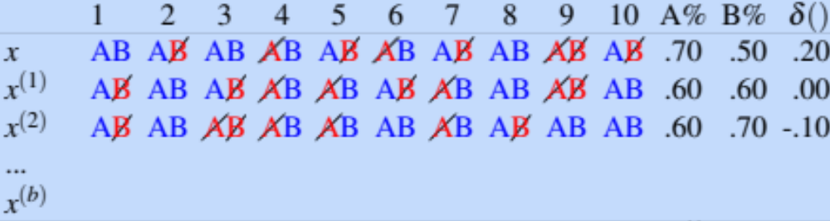
Bootstrap example
Now we create, many, say, b=10,000 virtual test sets x(i), each of size n = 10.
To make each x(i), we randomly select a cell from row x, with replacement, 10 times:

Slide 95
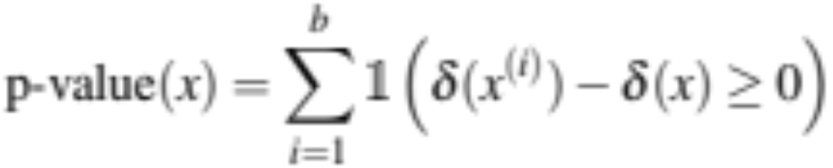
Bootstrap example
Now we have a distribution! We can check how often A has an accidental advantage, to see if the original 𝛿(x) we saw was very common.
Now assuming H₀, that means normally we expect 𝛿(x')=0
So we just count how many times the 𝛿(x') we found exceeds the expected 0 value by 𝛿(x) or more:

Slide 96
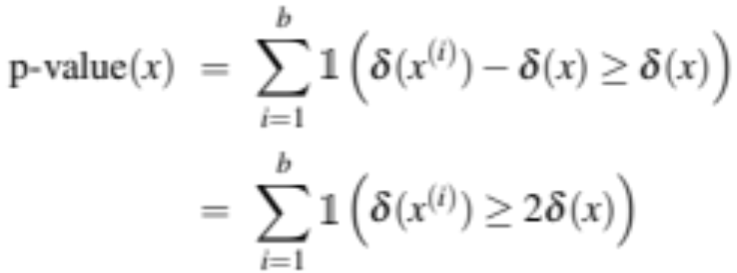
Bootstrap example
Alas, it's slightly more complicated.
We didn’t draw these samples from a distribution with 0 mean; we created them from the original test set x, which happens to be biased (by .20) in favor of A.
So to measure how surprising is our observed δ(x), we actually compute the p-value by counting how often δ(x') exceeds the expected value of δ(x) by δ(x) or more:

Slide 97
Bootstrap example
Suppose:
  We have 10,000 test sets x(i) and a threshold of .01
  And in only 47 of the test sets do we find that δ(x(i)) ≥ 2δ(x)
  The resulting p-value is .0047
  This is smaller than .01, indicating δ (x) is indeed sufficiently surprising
  And we reject the null hypothesis and conclude A is better than B.

Slide 98
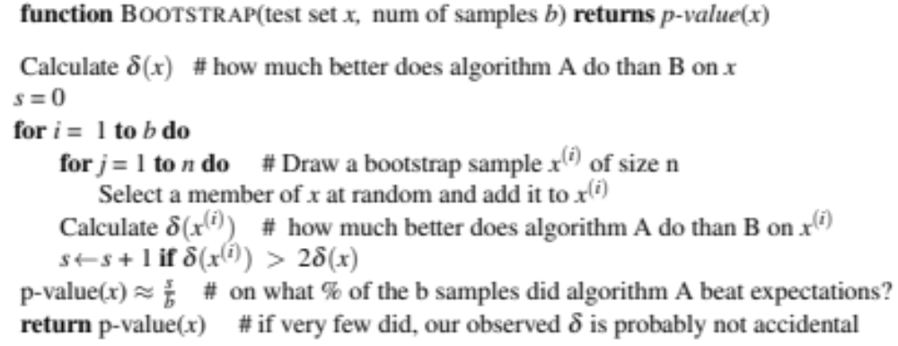
Paired bootstrap example
After Berg-Kirkpatrick et al (2012)

Slide 99
Text Classification and Naive Bayes
The Paired Bootstrap Test

Slide 100
Text Classification and Naive Bayes
Avoiding Harms in Classification

Slide 101
Harms in sentiment classifiers
Kiritchenko and Mohammad (2018) found that most sentiment classifiers assign lower sentiment and more negative emotion to sentences with African American names in them.
This perpetuates negative stereotypes that associate African Americans with negative emotions

Slide 102
Harms in toxicity classification
Toxicity detection is the task of detecting hate speech, abuse, harassment, or other kinds of toxic language
But some toxicity classifiers incorrectly flag as being toxic sentences that are non-toxic but simply mention identities like blind people, women, or gay people.
This could lead to censorship of discussion about these groups.

Slide 103
What causes these harms?
Can be caused by:
  Problems in the training data; machine learning systems are known to amplify the biases in their training data.
  Problems in the human labels
  Problems in the resources used (like lexicons)
  Problems in model architecture (like what the model is trained to optimized)
Mitigation of these harms is an open research area
Meanwhile: model cards

Slide 104
Model Cards
(Mitchell et al., 2019)
For each algorithm you release, document:
  training algorithms and parameters
  training data sources, motivation, and preprocessing
  evaluation data sources, motivation, and preprocessing
  intended use and users
  model performance across different demographic or other groups and environmental situations

Slide 105
Text Classification and Naive Bayes
Avoiding Harms in Classification

